Slide 1
More profit with data.
AI-supported process management for efficient store management.
Company: sell & pick GmbH
Foundation: 2015
Registered office: Munich
Industry focus: Food service / hospitality
Partner of strong brands in the industry:

Slide 2
WHAT ARE THE CURRENT CHALLENGES?
STAFF SHORTAGE
FLUCTUATION
HIGH COMPLEXITY
New staff is difficult to find
Dissatisfied employees quit more often, cause more costs
Seasonal fluctuations, events and unforeseeable occurrences require precise turnover and sales planning
INFORMATION GAP
GUEST SATISFACTION
RESOURCES ARE EXPENSIVE
Optimizations from the head office do not reach the implementers in the field
Understaffing leads to long waiting times and poor service quality, as well as lost sales
Personnel/goods are the highest cost block in hospitality

Slide 3
WHY SELL & PICK?
We help to overcome the biggest challenges
Targeted increase in sales & optimal contribution margin
Use data & AI-supported sales strategies to inspire your guests with the right offer at the right time.
Staff costs under control & optimum productivity
Data & AI-supported shift planning and targeted staff deployment allow you to reduce costs without compromising on quality.
Minimize goods costs & optimal goods printing
Reduce overstocks and stock-outs with data & AI-supported ordering processes and optimize your warehousing and sales areas.
Better planning and implementation with process intelligence
Rely on intelligent processes that help you to implement your planning more flexibly and efficiently for store/area management.
Simplify and accelerate processes
Standardize and automate processes using IT connectivity to run your business more efficiently and minimize errors.

Slide 4
Comprehensive process management platform
Our concept
for better results
More turnover and revenue with higher guest and employee satisfaction

Slide 5
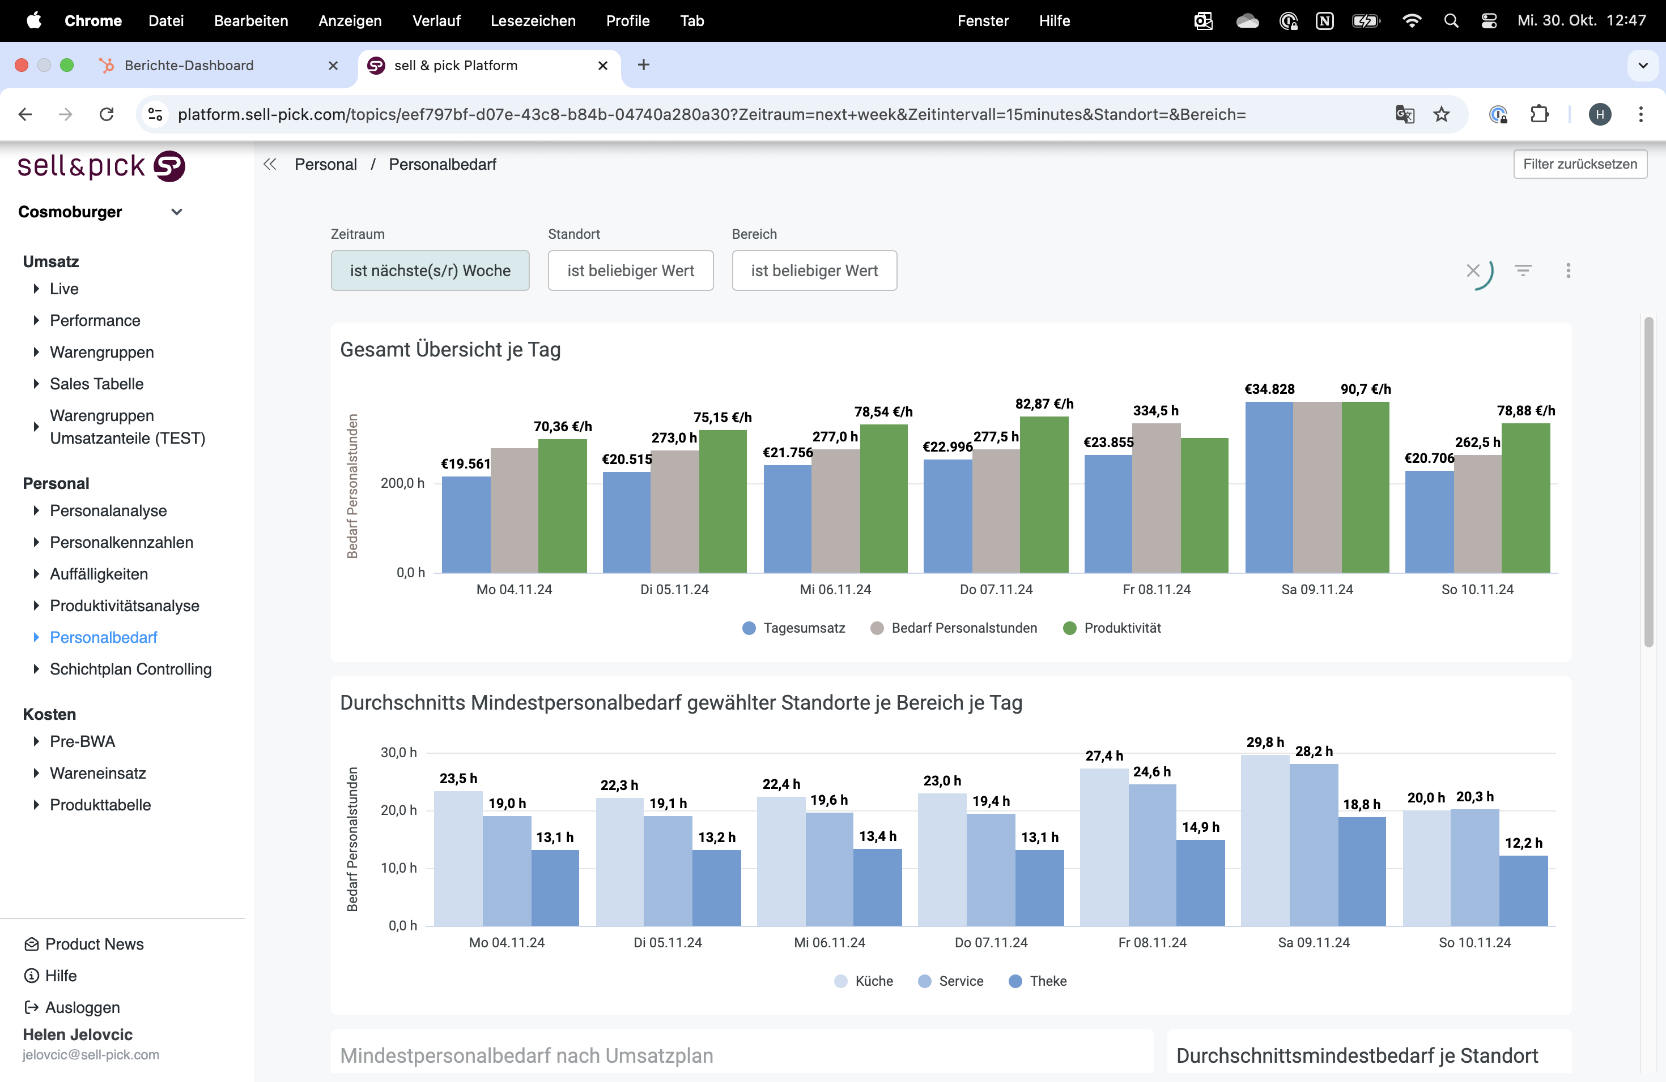
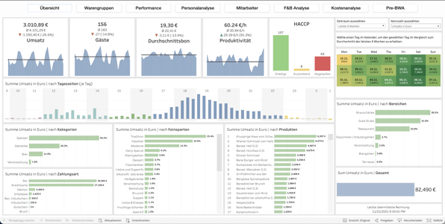
KI-SUPPORTED PLANNING & AREA MANAGEMENT
Define Measures
Recognize
Cause
carry out
Measures
Recognize the problem
Control Measures
Measuring success

Slide 6
OPTIMAL PLANNING AND MANAGEMENT

Slide 7
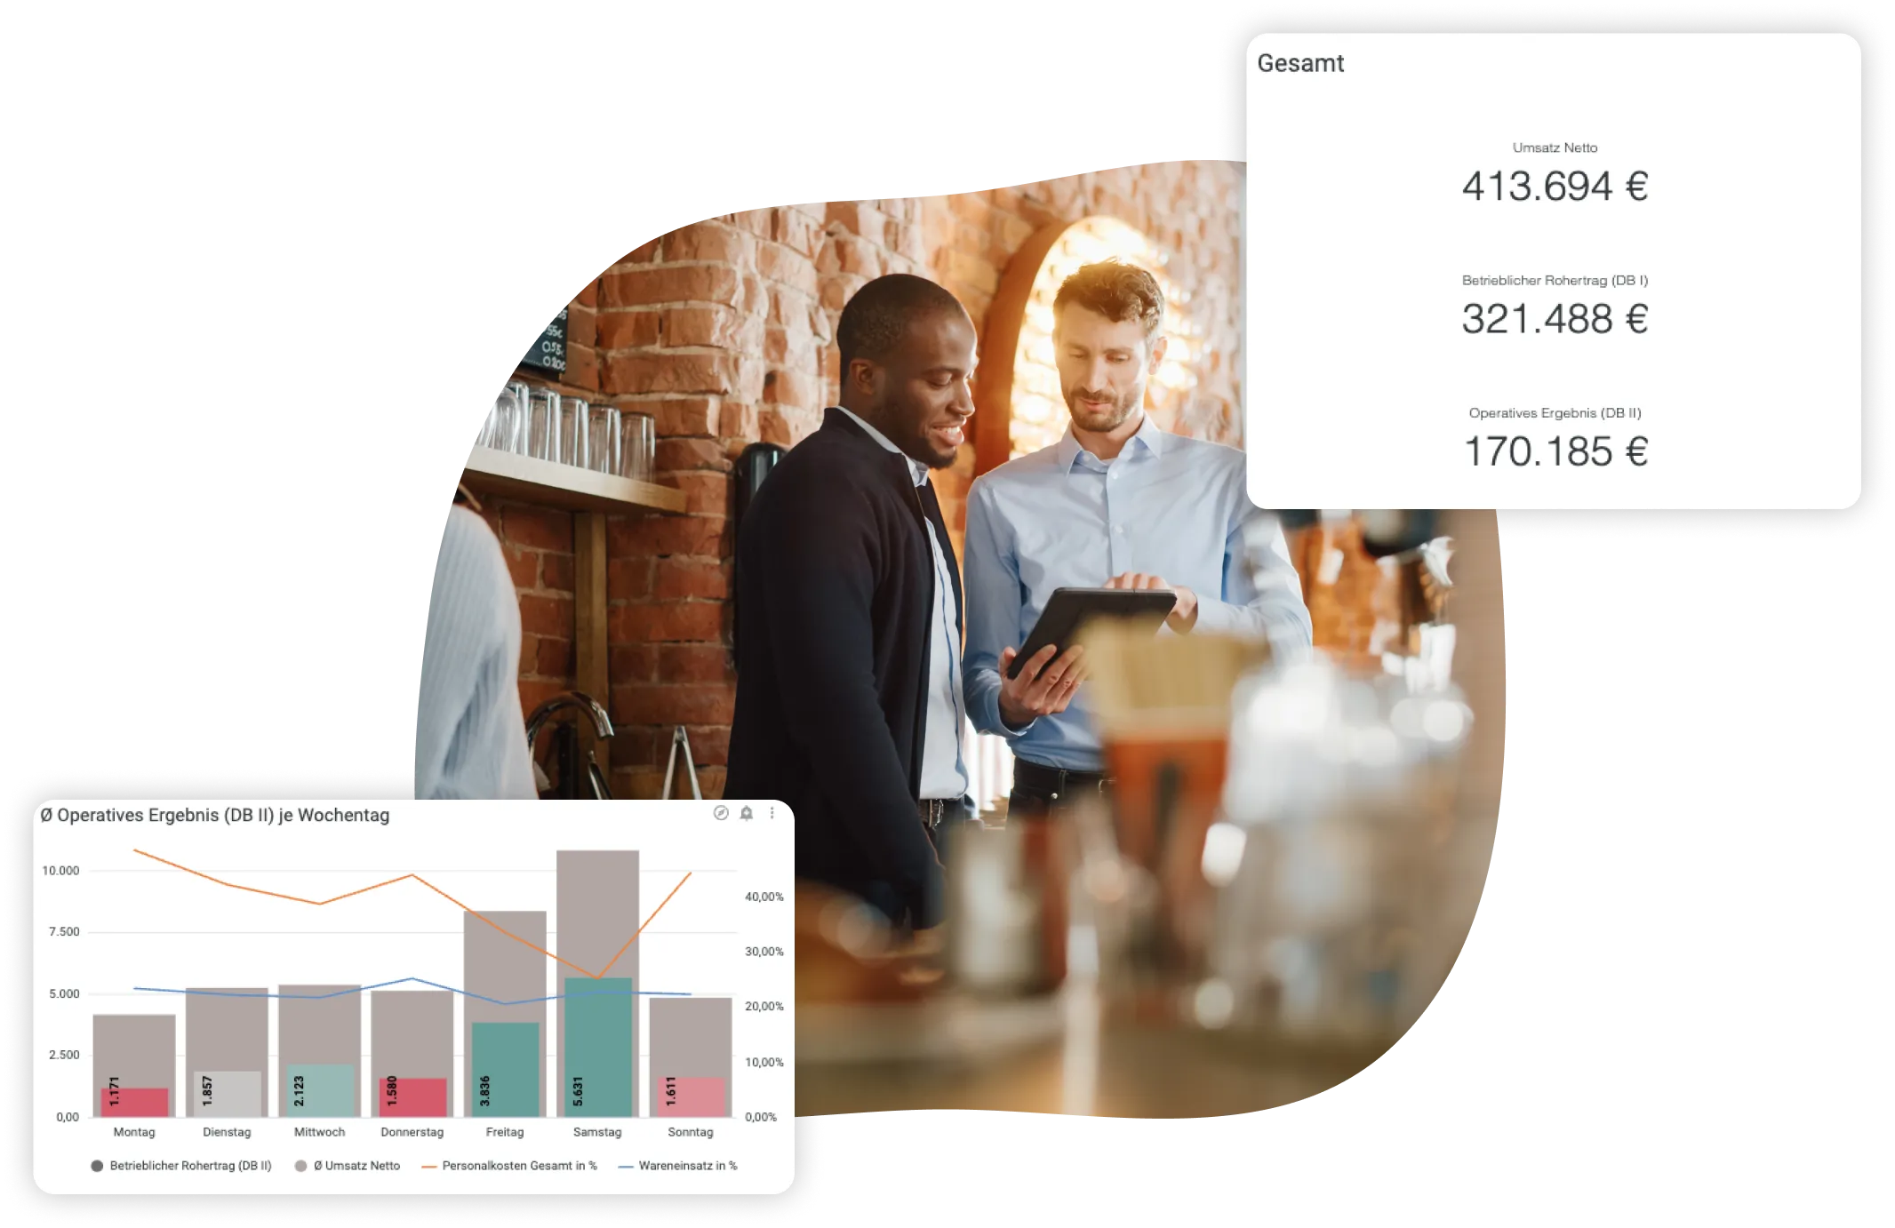
WHAT WE DO
Speed is KEY in turbulent times.
By providing real-time information from all operational process systems across the board, we help companies to achieve the necessary responsiveness for planning and implementation at branch level in order to react quickly to changes and operational challenges.
Significant increase in planning and implementation expertise without manual effort.

Slide 8
WHAT EXACTLY ARE WE DOING?
ALL PROCESS DATA IN ONE PLACE
AI ALGORITHMS
Complete analysis of all existing processes (goods, personnel, sales, OpsExc)
Specially optimized systems model the complex interrelationships of hospitality
PLANNING & CONTROL
Based on the results, adjustments are made to optimize planning and the changes are clearly communicated and constantly reviewed.
HOLISTIC PROCESS DEFINITION
STRONG NETWORK OF PARTNERS
Workshops to query and define the current status & define the ideal process with underlying goals
Direct intervention in the operational level via playout in the systems

Slide 9
OPTIMAL STAFF

Slide 10
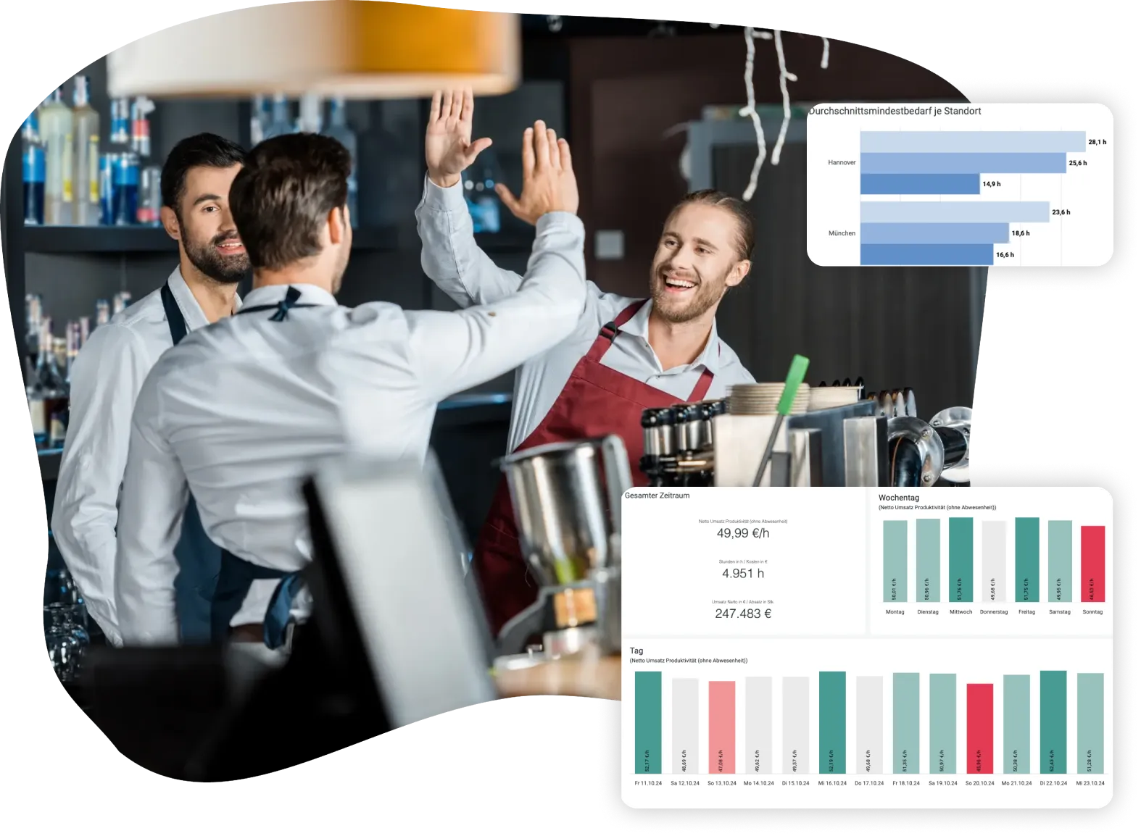
WHAT WE DO
Staff in food service are expensive and in short supply.
We help to deploy staff more effectively and with greater satisfaction by increasing planning and implementation skills throughout the company, regardless of experience.
This enables you to achieve an increase in staff productivity.

Slide 11
WHAT EXACTLY ARE WE DOING?
OVERALL TRANSPARENCY
FREQUENCY-OPTIMIZED STAFF PLANNING
Complete processing of data from the HR system in real time
Connection of the POS system and identification of potential based on the defined target values
AUTOMATIC SHIFT PLAN
Automatically generated shift envelopes for staffing in the personnel system
DEFINITION OF PROCESS
MODEL CONSTRUCTION & TRAINING
Workshops to query and define the current status & define the ideal process with underlying goals
Creation of a digital process twin and connection to the optimization logic

Slide 12
OPTIMAL GOODS

Slide 13
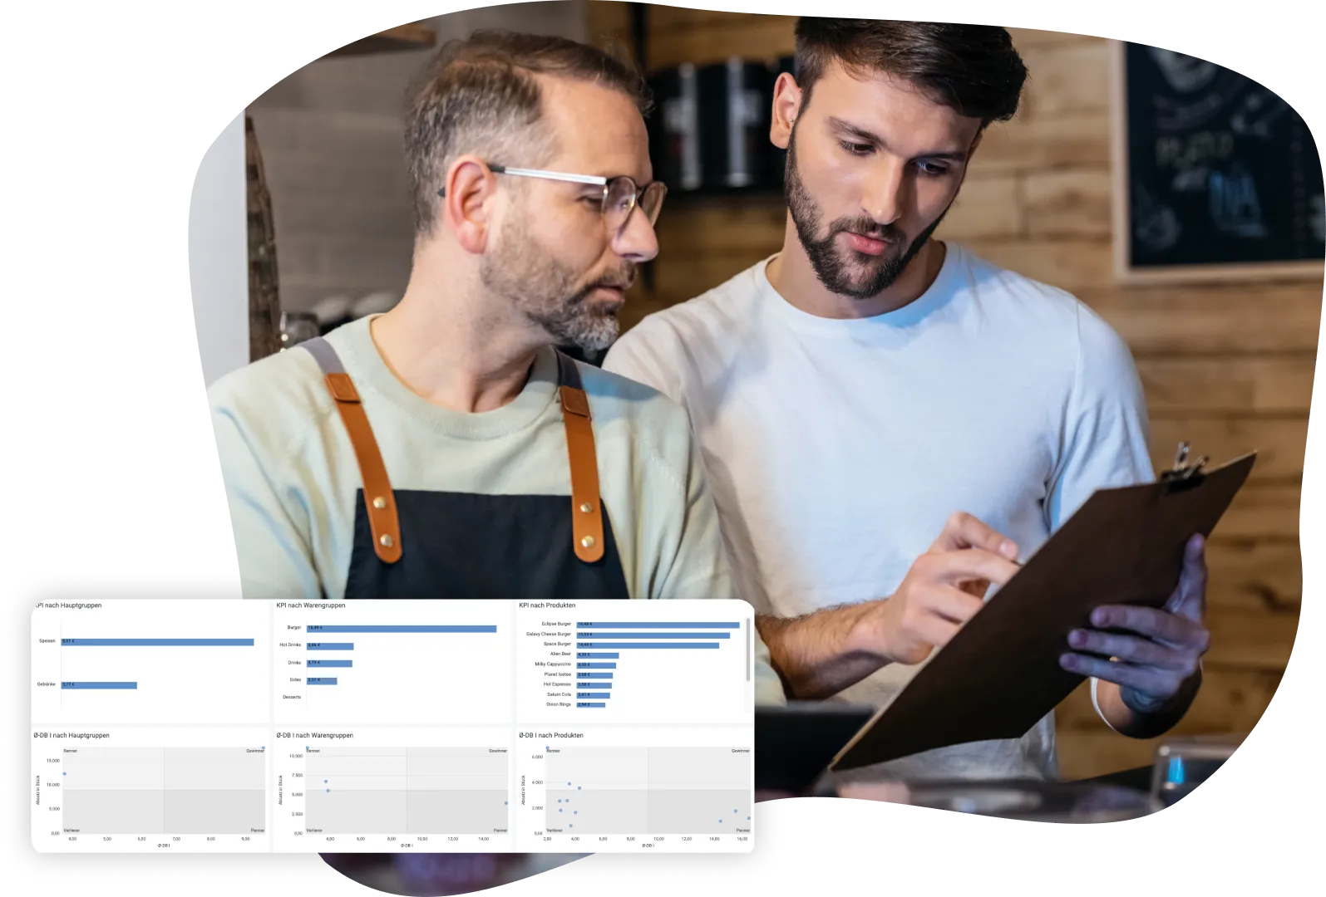
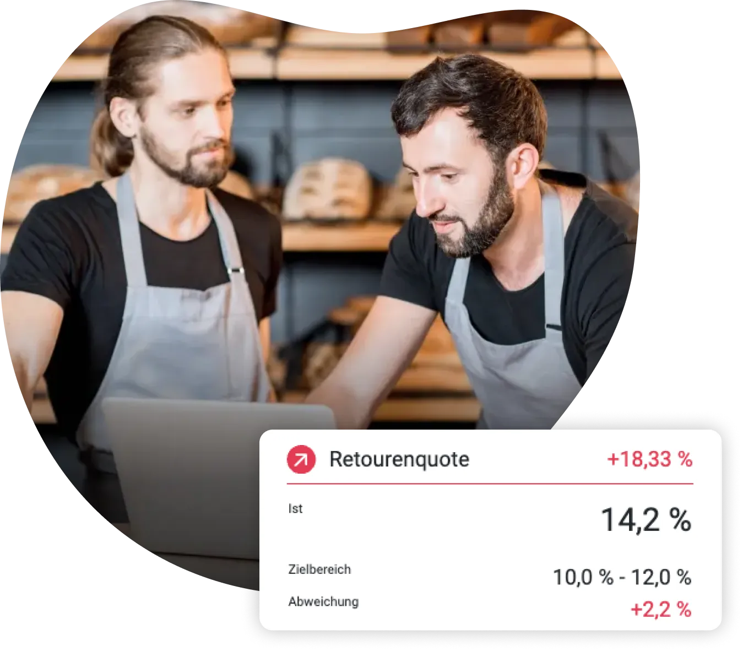
WHAT WE DO
Efficient management of the flow of goods and logistics is an essential component of profitable hospitality management.
We support the entire merchandise management process. From demand quantity analysis and contribution margin analysis to efficient consumption control. Control your operations with SMART recommendations for action through to fully automated ordering.
This allows you to optimize consumption quantities and availability.

Slide 14
WHAT EXACTLY ARE WE DOING?
OVERALL TRANSPARENCY
OVERALL
TREND ANALYSES
From calculatory to actual cost of goods sold, Renner/Penner on DB analyses and much more.
All key figures at a glance with benchmark to potential/previous year and early warning options
SALES-ORIENTED ORDER QUANTITIES
PLANNING
Optimized product management to reduce food waste while maintaining product availability
OVERALL
PROCESS DEFINITION
OVERARCHING
FOCUS
Workshops to query and define the current status & define the ideal process with underlying goals
Role-specific preparation of key figures - always keeping the most important things in mind

Slide 15
OPTIMAL REVENUE

Slide 16
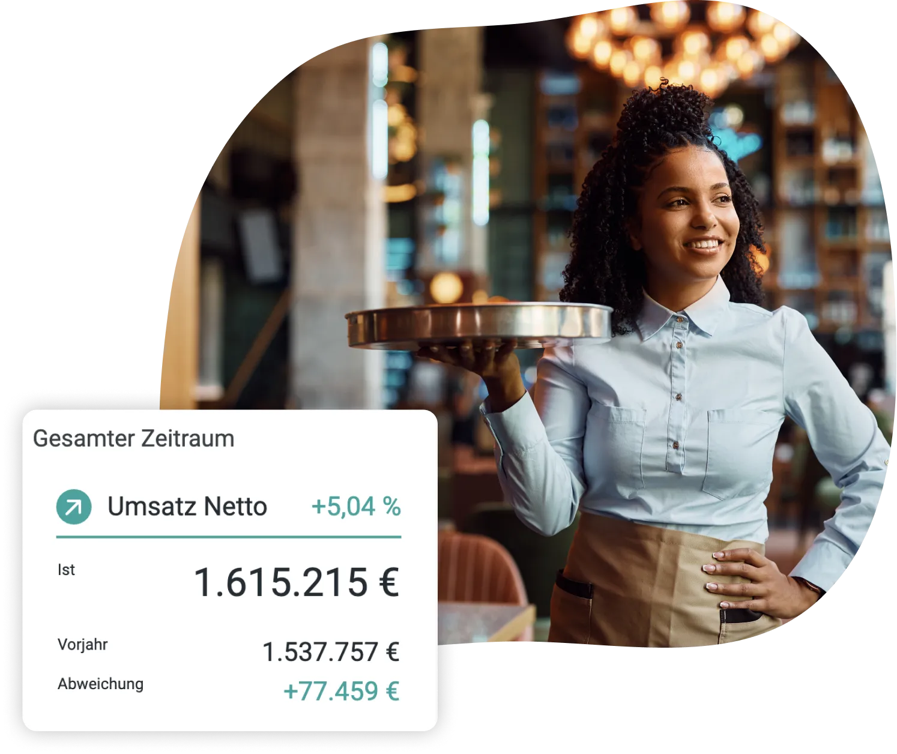
WHAT WE DO
Discover the full potential of your employees and products
The hospitality industry is changing: falling customer numbers and rising costs are presenting businesses with new challenges.
To remain competitive, businesses need to optimize and manage their sales in a targeted manner.
We provide you with clear strategies for identifying sales-boosting measures and measuring their success.

Slide 17
WHAT WE EXACTLY DO
OVERALL TRANSPARENCY
EXCEPTIONAL
PLANNING & BUDGETING PROCESS
Sales and merchandise management data from each store to identify profitable products.
Classification in the overall context of the company
ACTIVE
SELLING
We offer you the basis for implementing sales-boosting measures on the sales floor
EXCEPTIONAL
CUSTOMER KNOWLEDGE
EXCEPTIONAL
COMMUNICATION PLATFORM
We help you build a sales strategy that fits your corporate brand.
Process and exchange for target and promotion discussions

Slide 18
FOCUS ON THE
ESSENTIAL
WITH THE ABILITY TO GET A LITTLE BETTER EVERY DAY

Slide 19
We look forward to further discussions

